Slide 1
Creating novel experiences for interacting with media
Dr. Steven M. Drucker
Lead Researcher
Next Media Research Group
Microsoft Corporation

Slide 2

Overview
Role of Design and software development
New experiences, new interfaces: an example
Rapid prototyping of novel interfaces
  Why novel interfaces?
  Why rapid prototype?
  How to do it now?
  Baby steps: Generalized List Widgets

Slide 3
Overview (continued)
Application domain: media browsing: DEMOS
  Finding media: Movie Variations, MediaBrowser
  Browsing media: TimeQuilt:
    Evaluation
  Moving within media: SmartSkip
    Evaluation
Vision Pieces:
  Spectator

Slide 4


Current software development
“Projects get a green light right at the start, and go directly to engineering. The next phase is when they ship—usually late, with bugs, over budget and missing functionality.“
“… demonstrable myth that we know what we want at the start, and how to get it, and therefore build our process assuming that we will take an optimal, direct path to get there. Nonsense … the sooner we make errors and detect and fix them, the less (not more) the cost.”
Engineering
Sales
Proceedings of the Second International Conference on Usage-Centered Design.Portsmouth, NH, 26-29 October 2003, pp. 1-15.
http://www.foruse.com/2003/
Bill Buxton: www.billbuxton.com

Slide 5
The role of design
Design
Engineering
Sales
“Inserting an explicit design process at the front end, prior to green lighting the project. The process is represented as a funnel, since the number of concepts to emerge is always anticipated to be fewer than enter.”
From Bill Buxton: www.billbuxton.com

Slide 6
Components of Design
Sketches
Storyboards
Videos
Prototypes
Evaluation
Novel Experiences
Cull
Evaluate
Pick
Iterative Design
Adapted from Bill Buxton: www.billbuxton.com

Slide 7
Why novel interfaces?
Need both next versions AND new experiences
  Next version gets harder with each iteration
New capabilities:
  Moore’s law: how can we improve interaction?
New problems:
  Information overflow
  Ubiquitous computing
New expectations:
  Emotional design: iPod example

Slide 8


An example vision: Blitz UX
Joint collaboration between the Windows Shell UX team and Next Media Group
Vision piece for how a broadband website might take advantage of rich 3d and multi layered graphics compositing on the desktop.

Slide 9
Why rapid prototype?
Need to quickly try many new ideas.
Need to iterate on design concepts.
Need to test ideas with diverse users.
Subtle interactive refinement can be crucial.

Slide 10
Rapid prototyping of novel interfaces: How to do it now?
Existing tools:
  Flash, Director
    Difficult to integrate with databases and other components
    Don’t handle bitmaps or video well
    Not 3D
    Scattered programming model
  Anark: 3D but no same problems as above
  C++: difficult to create novel interfaces
  Toolkits/Languages: Piccolo, Python, and beyond…
In house tool:
  “Game-engine” for user interfaces.
  Designer as “mod developer”
  Object/behavior separation
  Dynamic Languages, faster iteration of designs
  Don’t start from scratch every time

Slide 11

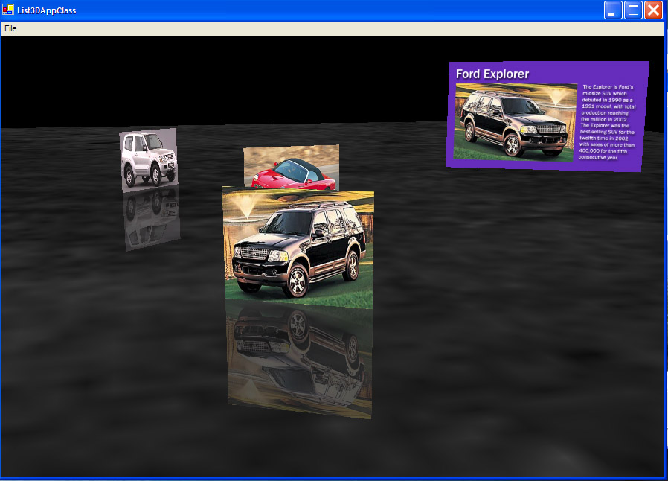
Example: Generalized List Control
Creation of rich reusable components
Let designers iterate without developers in the loop
With Kentaro Toyama

Slide 12


Domain for applying novel interfaces
Media Interaction:
Text doesn’t help
(no, or limited metadata)
Challenging:
    Large numbers
    Immediately understandable
Emphasis on usability
(won’t get used otherwise)

Slide 13
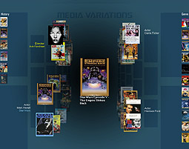
Movie Variations:
Browsing multidimensional information using movies as an example content.
Explores browsing local area
Uses “6 degrees of separations”
Applicable to many different domains
With Asta Roseway

Slide 14
Movie Variations: Implementation
Uses DirectX9
Written entirely in C# on .NET Framework
Accesses a database of 17000 films originally built for a universal metadata project all stored within SQL.
Can use other techniques for clustering data (collaborative filtering, metadata, etc.)
Can be applied to other domains.
Media Variations Client
.NET Framework
SqlConnector
DX9
Graphics Display
(needs GeForce2
equiv or better)
SQLserver

Slide 15
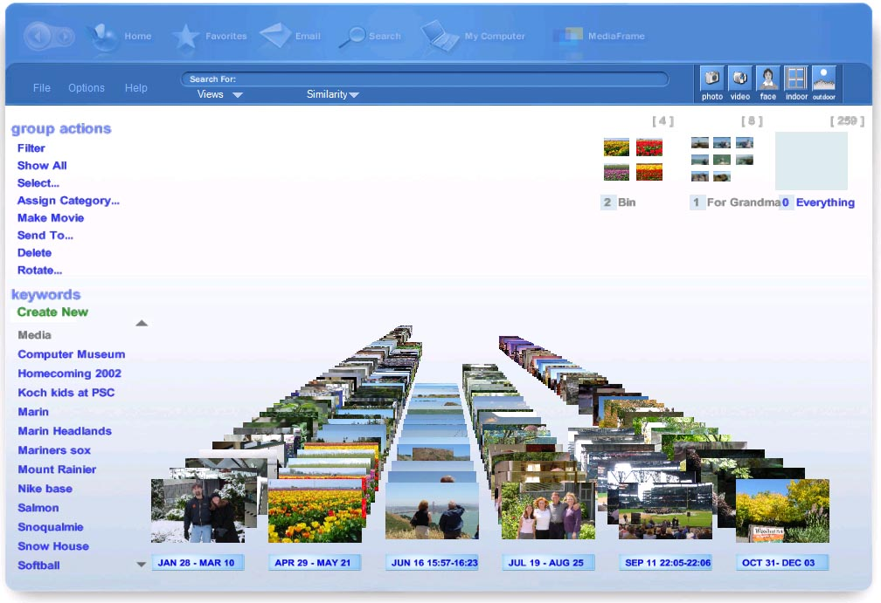
Media Browser
Effective browsing and annotation of personal photos
Leverage clustering and analysis of photos for annotation
Effective filtering to find images
Use animation and 3D effectively
Drucker, S. C. Wong, A. Roseway, S. Glenner, S. De Mar, MediaBrowser: Reclaiming the Shoebox. in Proceedings of AVI2004, Gallipoli, Italy, 2004.

Slide 16
Media Browser: Implementation
Media Browser Client
Media Browser Client
ACTIONS
.NET Framework
ORGANIZERS
ODBC
DX9
VIZUALIZERS:
(Timeline
& Tabular)
METADATA
- manual
- automatated
Keywords
TimeSlider
Attributes
Faces
Graphics Display
(needs GeForce2
equiv or better)
FILTERS
Access (later winFS)

Slide 17
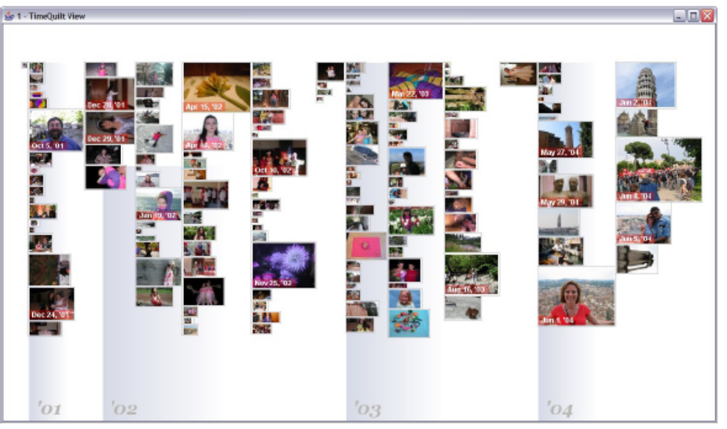
TimeQuilt
Scaling up Zoomable Photo Browsers for Large, Unstructured Photo Collections
Dealing with 10,000’s of photos
Just use implicit metadata
Use temporal clustering and representative thumbnails
Huynh, D., Drucker, S., Baudisch, P., Wong, C.
Time Quilt: Scaling up Zoomable Photo Browsers for Large, Unstructured Photo Collections. CHI 2005. Portland, OR. Apr. 2005

Slide 18

Basic Algorithm

Slide 19
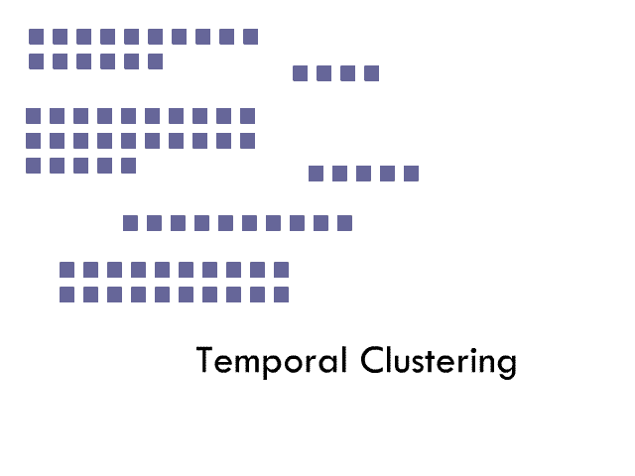
Basic Algorithm

Slide 20
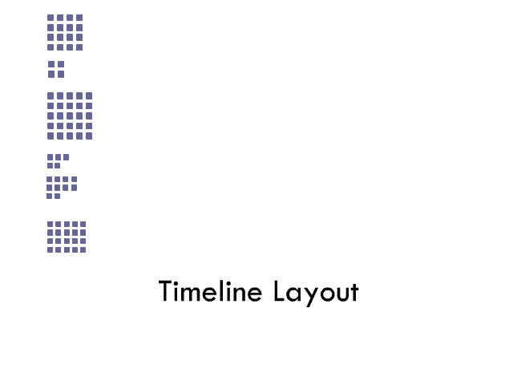
Basic Algorithm

Slide 21
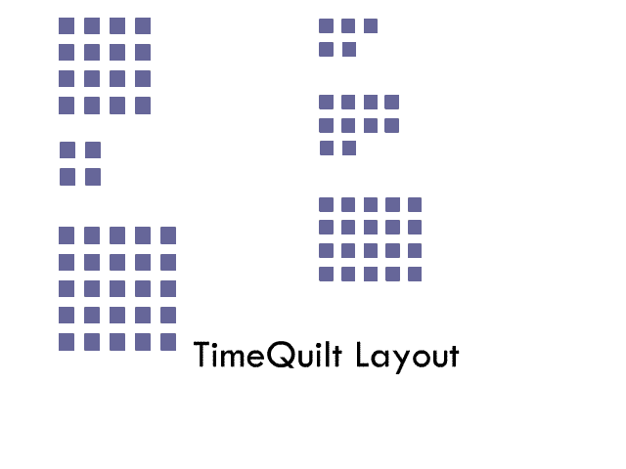
Basic Algorithm

Slide 22
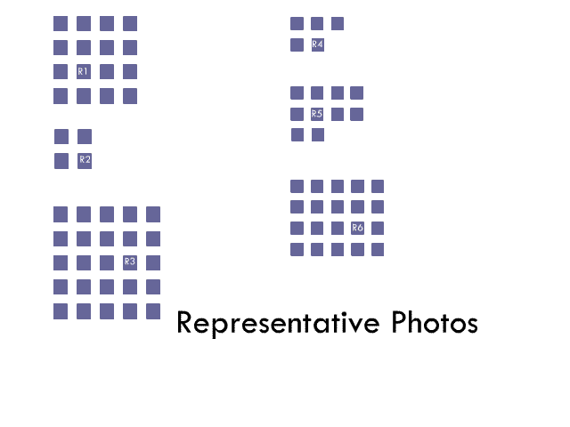
Basic Algorithm

Slide 23
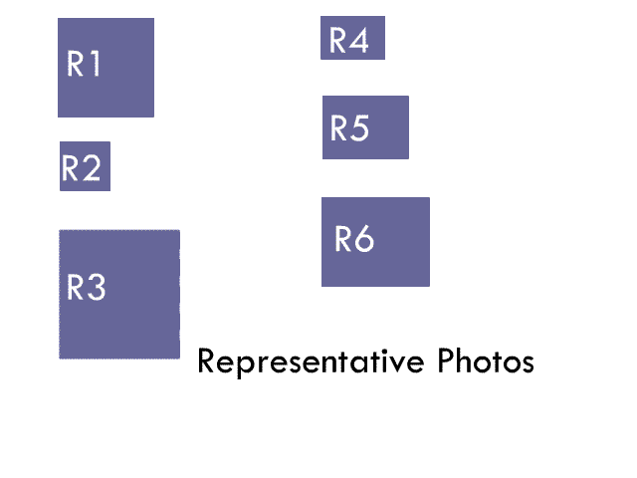
Basic Algorithm

Slide 24
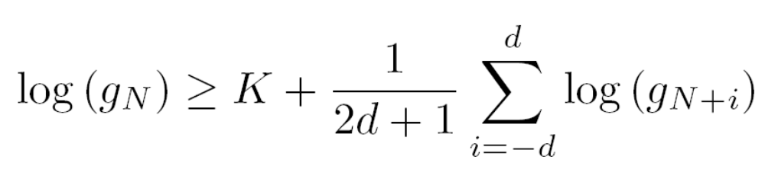
Temporal Clustering
Algorithm from Platt et al …
g_{i} is gap between picture i and picture i+1
d is window size (chosen to be 10 pictures)
K is empirical threshold (chosen to be 17)
Compares a gap to the a local geometric average of gap times, and declares an new event when the difference is large enough.

Slide 25
Representative Photo Selection
We used “dumb algorithm”
  first or middle picture from a cluster
Could do other things:
  See Lim et al. “Content based summarization for personal image library”, Proceedings of the 3rd ACM/IEEE-CS joint conference on digital libraries, 2003.

Slide 26
Demo
TimeQuilt

Slide 27
Experiment: Retrieving Photos
Within subjects design:
3 different interfaces tried:
  Space filling, timeline and timequilt layouts
Space filling tried with and without representative photos
10 subjects (8 male, 2 female)
Subjects had between 2863 and 5708 photos
Each participant selected 28 favorite photos
Randomly divided selected photos into 4 groups
2 Training photos and 5 photos for actual test

Slide 28
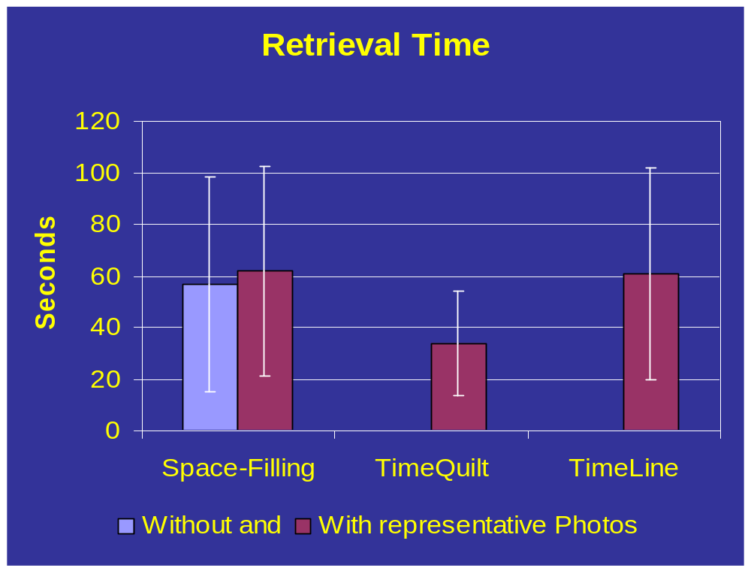
Results

Slide 29
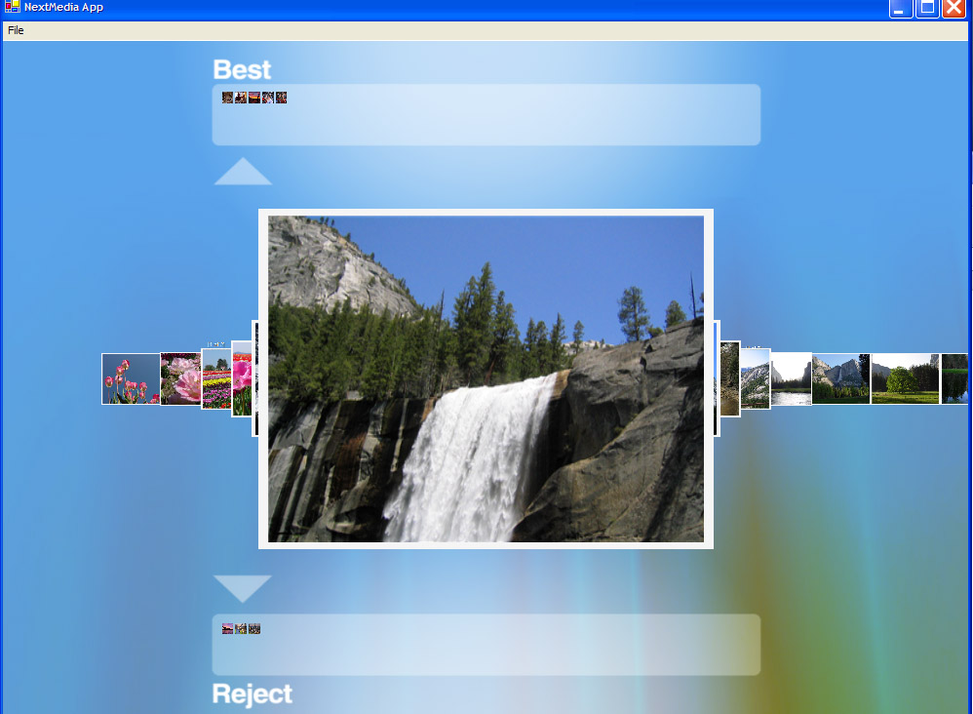
Phototriage
Rapid initial sorting and metadata assignment to picture thumbnails.
Rapidly iterating through a collection and selecting out “good” photos.
Uses rapid serial presentation techniques, clustering
Implicit metadata assignment
MSR-TR-2003-97
Photo-triage: Rapidly annotating your digital photographs
Steven Drucker; Curtis Wong; Asta Roseway; Steve Glenner; Steve De Mar
December 2003

Slide 30
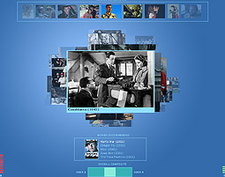
Visual Decision Maker:
A collaborative 3D interface designed for browsing through media.
Multiple, simultaneous users
Visual Dialog between users and computer
Adaptive behavior
Collaborative recommendations
MSR-TR-2002-77
The Visual Decision Maker – A Movie Recommender for Co-Located Users
Tim Regan; Steven Drucker; Markus Lofstrom; Asta Glatzer
October 2002

Slide 31
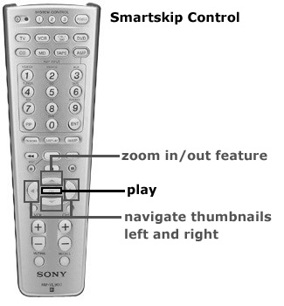
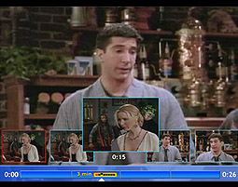
SmartSkip:
Convenient skipping and browsing of digital video from a remote control.
Thumbnail view interface for skipping and browsing digital video.
Adjust time variation with shot detection
User study comparing this system with systems alternatives
Drucker, S., Glatzer, A., De Mar, S and Wong, C. SmartSkip: Consumer level browsing and skipping of digital video content. In Proceedings of CHI 2002, Minneapolis, Minnesota, 2002

Slide 32
Background
Video Browsing and Skimming
  Informedia project
  Video surrogates: [Elliot ’93], [Komlodi ’98]
  Skimming [Li ’00], [Christel ’98]
Most tend to be for computer monitor (close up) and not for consumer use.
But many show the utility of having a storyboard (spatial) layout as opposed to temporal layouts [Tse et al ’99].

Slide 33
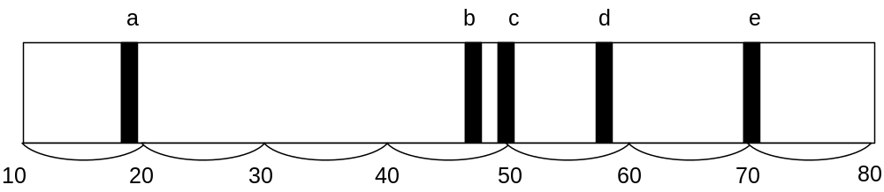
Implementation
Combine shot detection with evenly spaced temporal skipping.
  Use rapid changes in overall color and brightness. Doesn’t currently detect fades.
Use thumbnails from moments after the detected shot.
Used infrared keyboard and programmable remote controls.

Slide 34
User study: Experimental Design
Independent variables:
  Interfaces (3 treatments): Skip, Multiple levels of fast-forward, SmartSkip
  Tasks (2 treatments): Commercial skipping and weather segment finding.
Dependent variables:
  Task performance: accuracy, time to completion, # of clicks to completion
  Subjective satisfaction: ranking, ease of use, ease of learning, frustration, fun

Slide 35
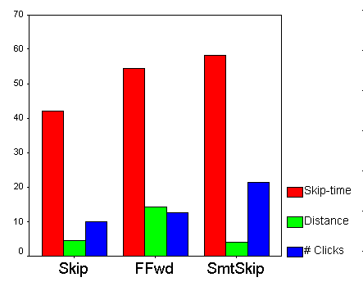
User study results: quantitative, commercial skipping task
Quantitative performance in seconds and # of clicks for commercial skipping.
Statistically significant for time between skip and other 2 interfaces
Statistically significant difference between SmartSkip and other 2 for # clicks

Slide 36
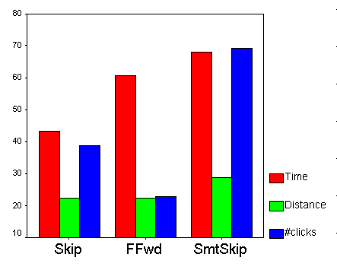
User study results: quantitative, weather segment finding task
Quantitative performance in seconds and # of clicks for weather segment finding.
Statistically significant for time between skip and other 2 interfaces
Statistically significant difference between all pairs for # clicks

Slide 37
User study: subjective questions
# | Questions
1 | I found this interface easy to use.
2 | I found this interface easy to learn.
3 | I could skip commercials easily with this interface.
4 | I could find the weather section easily with this interface.
5* | I thought this interface was fun to use.
6* | I thought this interface was frustrating to use. (this is the only question where lower numbers indicate more satisfactory experience).

Slide 38
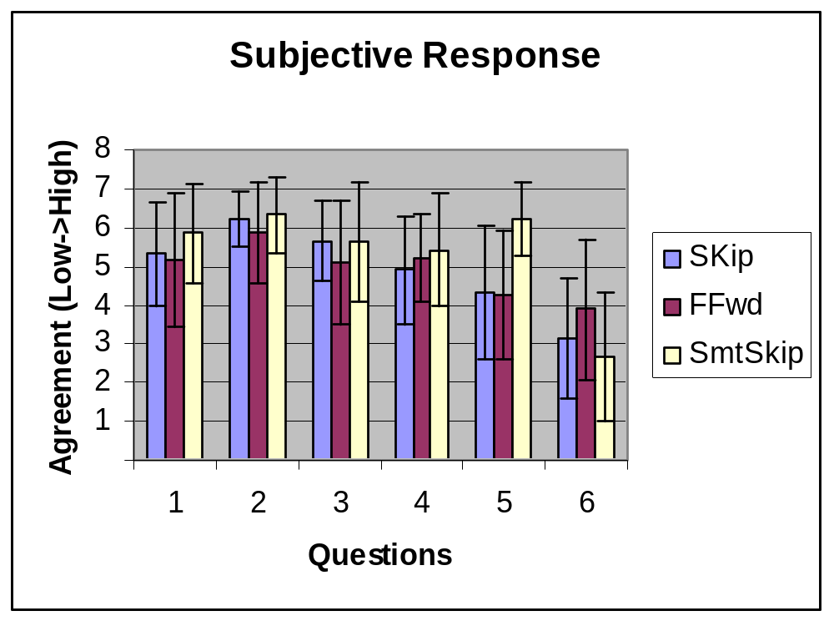
User study: subjective responses
Statistical significance for questions 5 (fun) and 6 (frustrating).

Slide 39
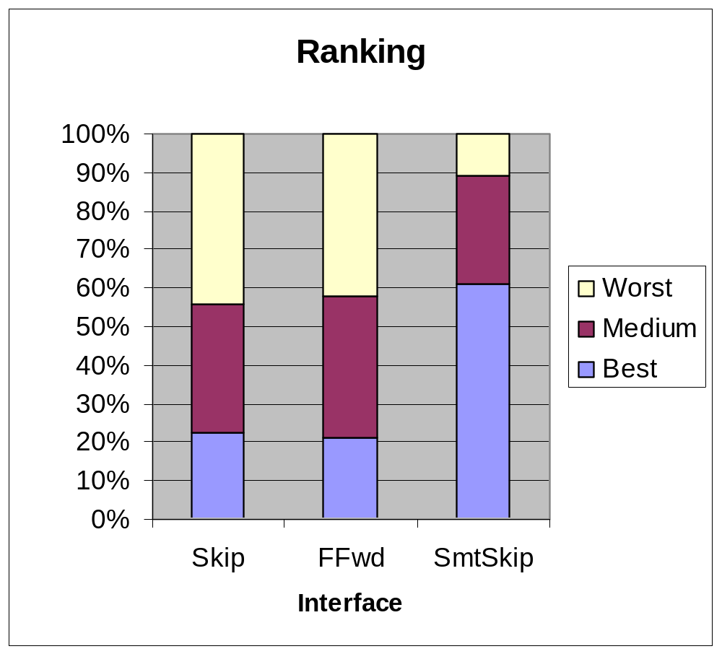
User study: subjective ranking

Slide 40
Smart Skip conclusions
Make sure you do both quantitative and qualitative evaluations, especially for consumer applications! What is the appropriate quantitative measure?
Untested hypothesis: the interfaces that require the user to attend closely to the display were found less ‘satisfying’.
Some problems were identified:
  Some people “got lost”
  Some found the thumbnails too small.
  Not clear what the best resolution to zoom in.
SmartSkip is a promising interface that combines the benefits of temporal and spatial layout of display.

Slide 41
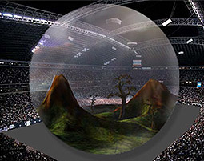
Spectator (from vision to features):
Web community based on Spectator enabled games
Enable community around video games
Use fame and learning
Vision, don’t worry about implementation
Keep in mind feasibility
Spectator Games: A New Entertainment Modality for Networked Multiplayer Games, 2000. http://research.microsoft.com/~sdrucker/papers/spectator.pdf

Slide 42
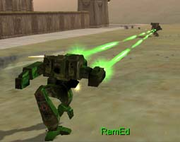
Spectator (automated game cameras):
Realtime in-game cinematic camera control
Chicken and egg problem
Automate expensive tasks
Demonstrate in real application
Drucker, S.M. Intelligent Camera Control for Graphical Environments PhD Thesis, MIT Media Lab. 1994.

Slide 43
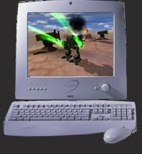

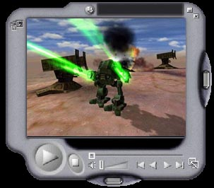
Technical approaches for Spectator (Video)
Video
Encoder
Video –
  Encode the one view of game in progress and broadcast that as streaming video
  Broadcast video of games in progress
Game machine
PROS
CONS
    Conventional encoding and streaming media technology can be used.
    No pre-distribution required
    Plays on simple media player
    No modification of source code
    Easily done
Requires second computer for encoding
Requires fast connection
Requires central server for rebroadcast
Scalability issues
Single choice of view

Slide 44
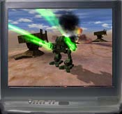

Technical approaches for Spectator (Game Engine)
Distributed Game Engine
  Pre-Distribute spectator only game engine and selected content
  Broadcast game state data to players
    Broadcast to one client, cascade to others
    Use index server to locate free resources
Index server
Game machine
PROS
CONS
Flexible game presentation (POV, replay, etc)
High quality playback with low bandwidth
May be best suited for Xbox business plan (advertising to people who already have the box)
Pre-Distribution may be through magazine or online service
Requires special purpose code for spectator engines
Requires optimized platform for receiving games (already owned)
Security concerns for distribution of content
May requires central server for rebroadcast
Scalability issues but easier to overcome
Spectator

Slide 45
Technical Tradeoff Issues (Video vs. Engine)
Developer work (Video)
  Most developers do not have time for any extra development for non-players
Amount of dedicated infrastructure and scalability (Engine)
  Dedicated any central services on a “per game” basis will be prohibitive except for large scale tournaments
Bandwidth (Engine)
  Current bandwidth constraints favor delivery of game engine commands as opposed to video for much better quality.
Security (Video)
  Though Xbox may be tougher to hack into games then PC environment.
Content/Engine Distribution (Video)
  Though there may be satisfactory mechanisms for predistributing engines and content. Can be value-add for magazine or xbox internet service. May make good use of existing hard disk on xbox.
Client Flexibility (Engine)
  Can allow for greater freedom in pausing, replaying, changing point of view. Though having a central video broadcast server can use manual directorial control.

Slide 46
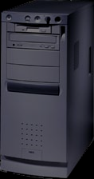
Preferred Approach (P2P fan out)
Index Server
Optional Game Spectator
Master Server
Individual game registers at central index server.
Spectators access index server to determine other spectators which are available to rebroadcast game data.
Optionally, a spectator master can be used for tournaments which can do analysis, optimization and stream information without peer-to-peer scheme.

Slide 47
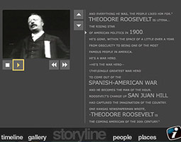
America 1900:
Enhanced television concept prototype of enhanced content from closed captions.
Vision piece
Analyze closed captions
Automatically generate related links

Slide 48
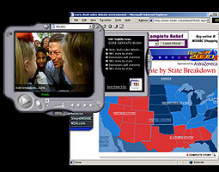
Deep News:
Working prototype of automated generation of links to news web pages
Video of working prototype
Uses Headline News
TV Tuner card -> extract closed captions
MindNet NLP -> extract keywords
Feed to news search engines

Slide 49
Some closing words:
Interaction design can make or break an experience.
Start early on in the process, often the earlier, the better.
Need to iterate on design concepts.
Need to build and test ideas with diverse users.
Ideas encourage other ideas, experiment!
Web site: http://research.microsoft.com/~sdrucker

Slide 50

© 2004 Microsoft Corporation. All rights reserved.
This presentation is for informational purposes only. Microsoft makes no warranties, express or implied, in this summary.
Notes:
© 2004 Microsoft Corporation. All rights reserved.
This presentation is for informational purposes only. Microsoft makes no warranties, express or implied, in this summary.
MGB 2003

